Slide 1
Walchand College of Engineering, Sangli
A presentation on
WHO IS THERE ?
By
Ajay Navgire(2018BTECS00006)
Tulsi Galande (2018BTECS00004)
Aditya Nanoskar(2018BTECS00048)
Guide
Mr. Anil Surve Sir

Slide 2
Abstract
Problem statement
Objectives
Methodology
Outcomes/Applications
Technology stack
UML Diagram
Gantt Chart
Customers / Users
Agenda:

Slide 3
In this Presentation, we present a guest recognition system using face detection.
This system will be able to perform the task of identifying the guests and send notification containing guest name and photo to owner.
Abstract:

Slide 4
To design a guest recognition system using face detection.
Problem Statement:

Slide 5
Build smart home/office application for users
To learn the skills of python and machine learning
To provide a security option for user
Get information about the guest/unknown person standing in front of camera
Objective:

Slide 6
At the end of project we will able to perform following tasks:
Recognition of guest/unknown person
Send notification to user
Outcomes

Slide 7
Coding Language: Python
Tech: Machine Learning
Libraries: Pandas, Tkinter, Numpy, Messagebox, CSV, CV2
Tech Stack

Slide 8
1. Haar cascades is a machine learning based approach where a cascade function is trained with a set of input data.
2. Haar Cascade is a machine learning object detection algorithm used to identify objects in an image or video.
3. It is a machine learning based approach where a cascade function is trained from a lot of positive and negative images. It is then used to detect objects in other images.
Methodology:1

Slide 9
Methodology:2
Using face_recognition library:
1.Find faces in pictures
2.Find and manipulate facial features in pictures
3.Identify faces in pictures
Use pushbullets library for sending notification

Slide 10
Methodology:2

Slide 11
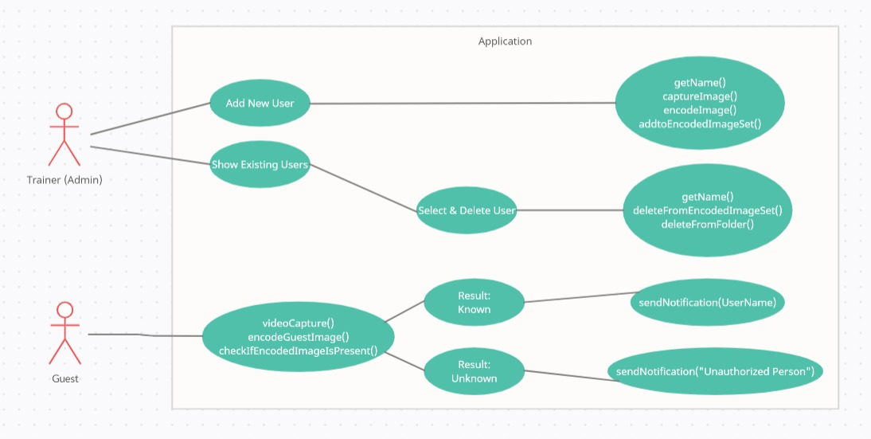
User case Diagram:

Slide 12
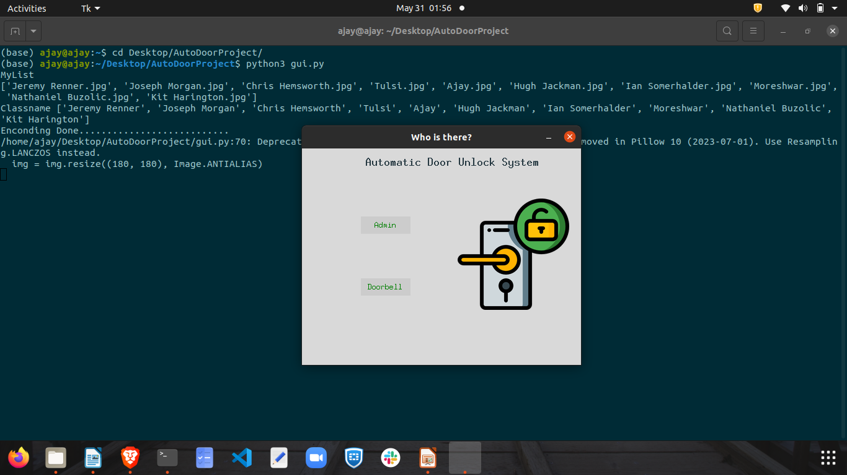

Slide 13
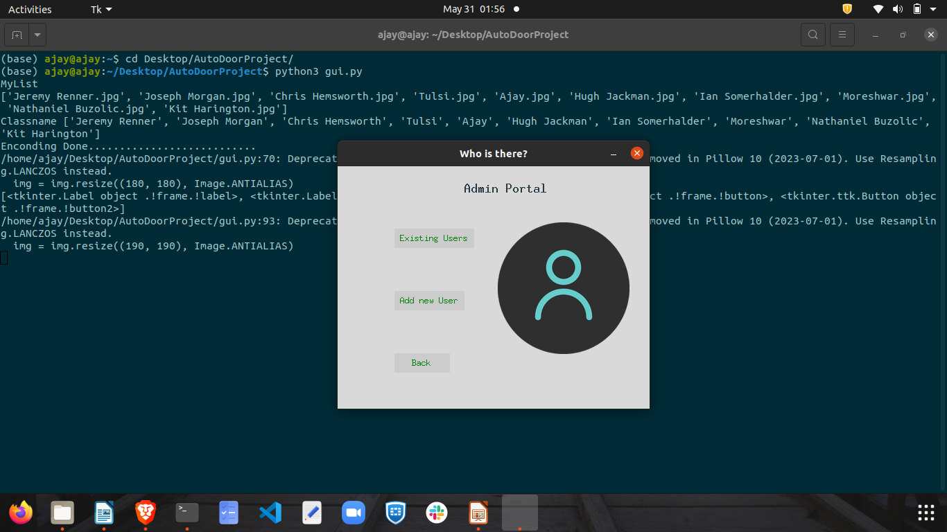

Slide 14
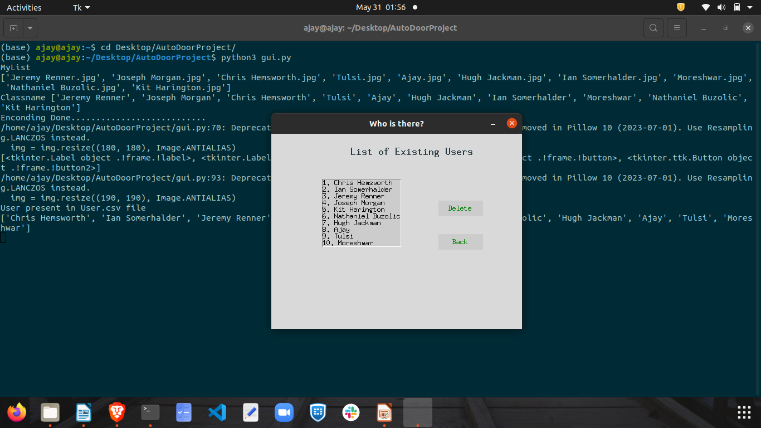

Slide 15
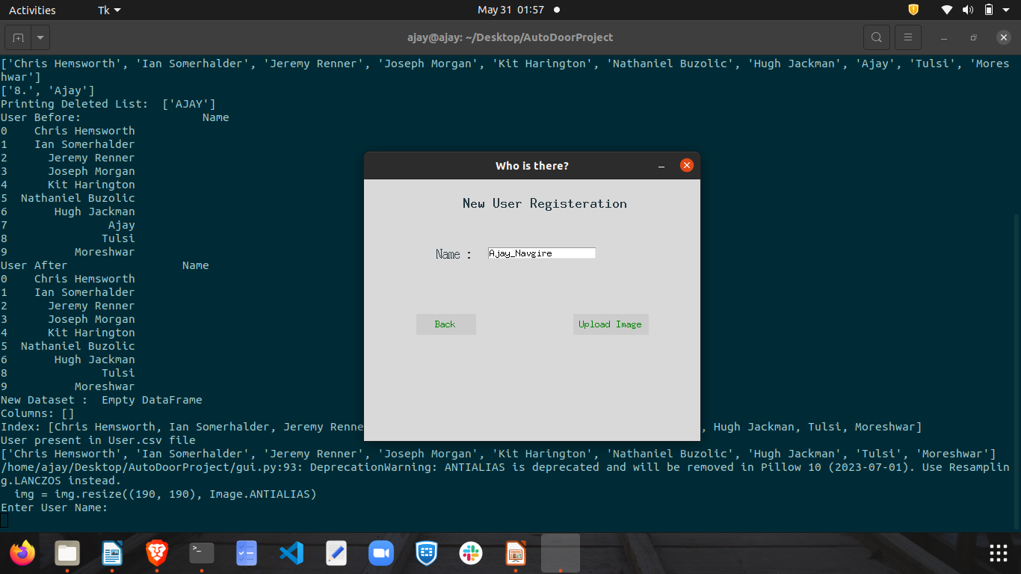

Slide 16
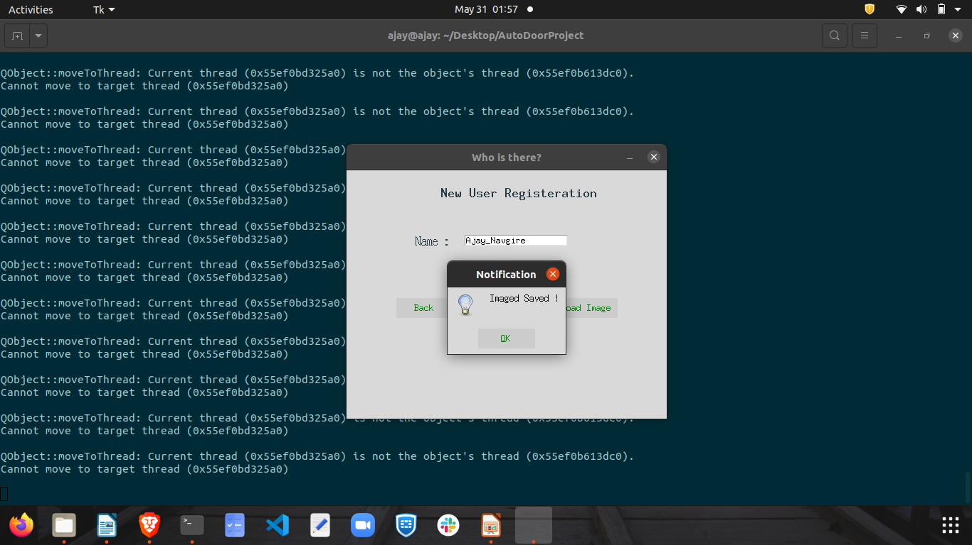

Slide 17
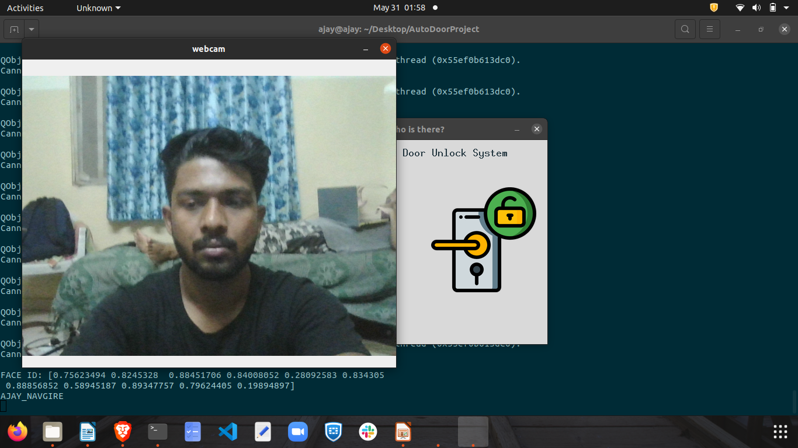

Slide 18
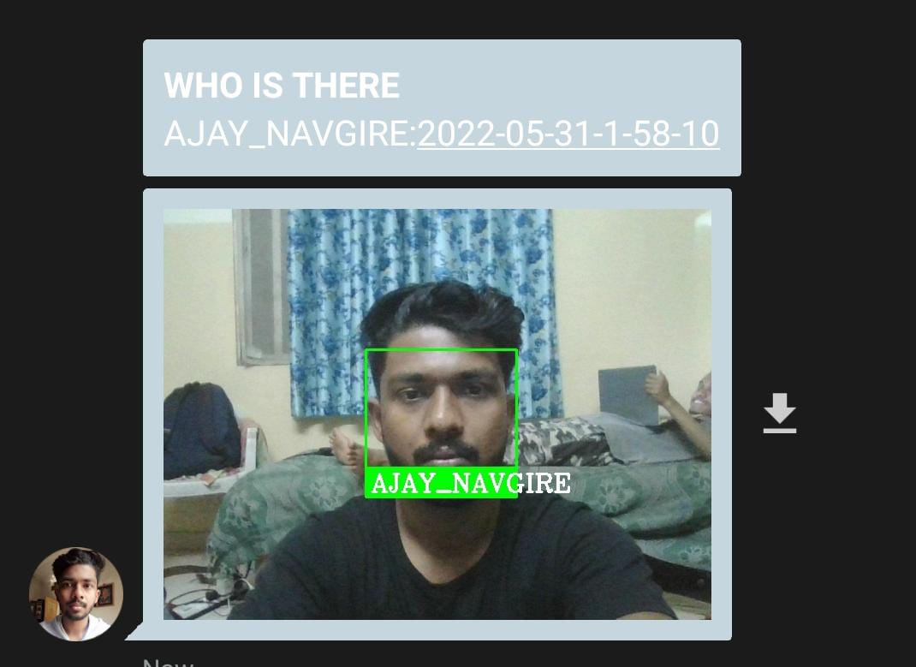

Slide 19
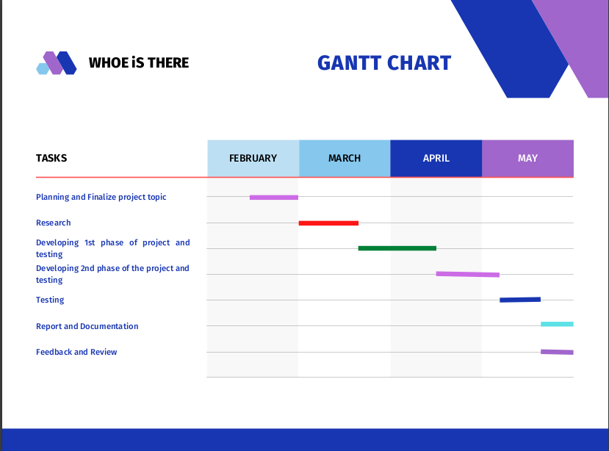
GANTT CHART

Slide 20
Agile development model:
No. | Requirements | Planning | Develop | Date | Feedback & Review | Deploy
1 | Finalize the project topic and discuss the technology stack will get used | Study / learn the required tech stack | - | 5 March |  | Done
2 |  | Developing first phase of project | Capture img and train model | 31 March |  | Done
3 |  | Developing second phase of project | Train ML model for face recognition | 30 April |  | Done
4 |  | Developing third phase of project | Send notification to the user | 27 May |  | Done
5

Slide 21
Customers / users
House Owners
For attendence purpose
Employee recognition

Slide 22
GitHub Link for code:
https://github.com/Ajay2000wce/Final_Year_Project

Slide 23
References:
https://www.w3schools.com/python/
https://opencv24-python-tutorials.readthedocs.io/en/latest/py_tutorials/py_objdetect/py_face_detection/py_face_detection.html
https://www.tutorialspoint.com/python/python_gui_programming
https://pythonhosted.org/face_recognition/readme.html
https://github.com/ageitgey/face_recognition
https://arsfutura.com/magazine/face-recognition-with-facenet-and-mtcnn/

Slide 24
Thank you!

